Slide 1
Team Digimon
LazyBot
Haiqiang Zou
Meiling Lin

Slide 2
Functions
To help you move an item from one place to another
Send robot’s visual data back to the phone application
15 pounds weight limit

Slide 3
Hardware/Software
Two wheels drive base
Camera
Bluetooth to connect the robot to the phone
Tray (to hold stuff for delivery)
Sonar Range Sensor
Android Application

Slide 4
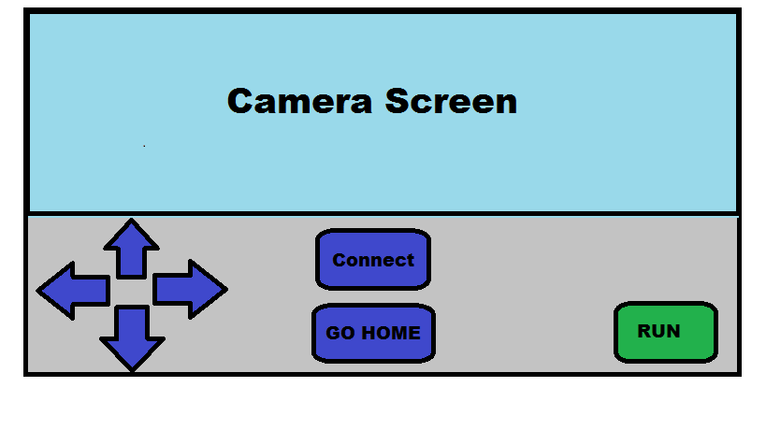
Android Application

Slide 5
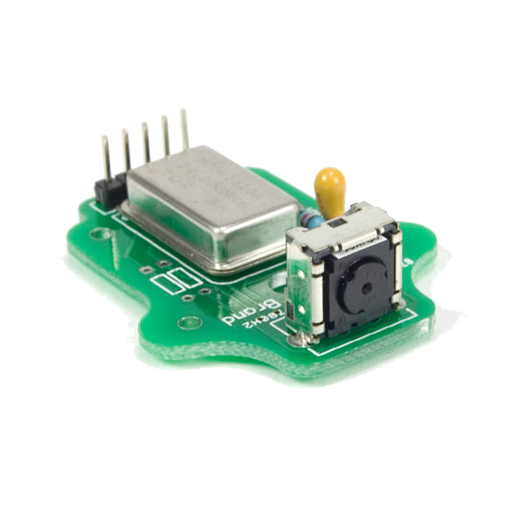
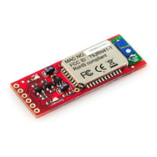
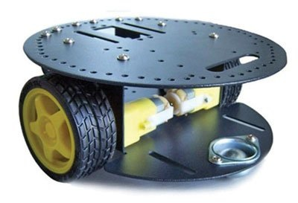
Components
Wii Camera Breakout Board
Bluetooth Mate Gold
2 Wheel Drive Arduino

Slide 6
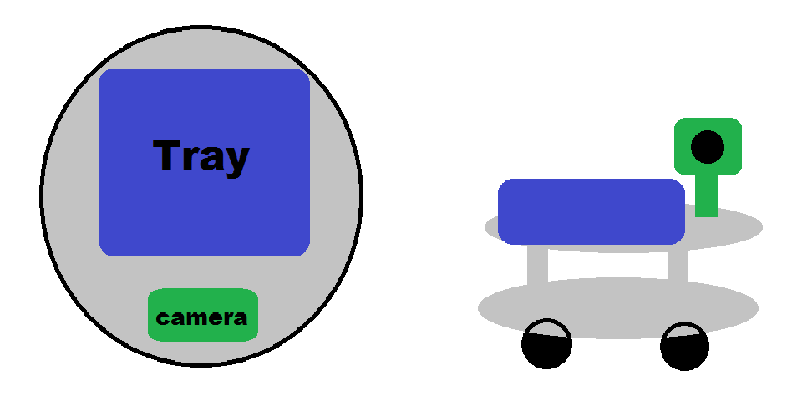
Sketch

